Slide 1
IMAGE RECOGNITION
Using Deep Learning
SUBMITTED BY:
ELAVARASAN M
513121104710
THANTHAI PERIYAR GOVERNMENT INSTITUTE OF TECHNOLOGY,VELLORE

Slide 2
AGENDA
Problem statement
Proposed solution
Algorithm and development
Result
Conclusion
References

Slide 3
PROBLEM STATEMENT
Challenges faced in traditional image recognition methods
Limitations of traditional approaches in handling complex and diverse image datasets
Need for more sophisticated algorithms to achieve higher accuracy and robustness

Slide 4
PROPOSED SOLUTION
Introduction to deep learning and its relevance in image recognition
Explanation of convolutional neural networks (CNNs) as the backbone of deep learning-based image recognition
Overview of how deep learning models can automatically learn hierarchical features from raw image data

Slide 5
ALGORITHM AND DEVELOPMENT
Detailed explanation of the CNN architecture
Description of the layers involved (convolutional layers, pooling layers, fully connected layers)
Discussion on the training process, including data preprocessing, loss function, optimization algorithm, and backpropagation

Slide 6
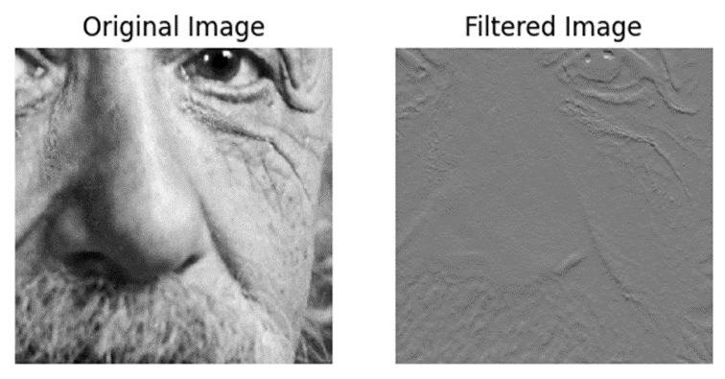
RESULT

Slide 7
CONCLUSION
Summary of key findings and insights
Importance of deep learning in advancing image recognition technology
Future directions and potential improvements in deep learning-based image recognition

Slide 8
REFERENCES
Pandas-https://pandas.pydata.org/
Numpy-https://numpy.org/
Matplotlib-https://matplotlib.org/
PIL-https://pillow.readthedocs.io/en/stable/

